Slide 1
Image style transform
Chen Jinye, Deng Bowen, Deng Chenguang, Qian Yicheng, Tu Zhi, Zou Muyang

Slide 2
Our Goal
Image Cartoonize

Slide 3
Related works
Cel-shading (Cartoon rendering)
Filtering
Segmentation
Neural networks stylization
depend too much on dataset
Image synthesis with GANs
mostly required paired images
CycleGAN
Notes:
基于我们的目标，我们做了一些调查工作，去了解现在已经有哪些方法去做卡通方面的风格转换。
首先是cel-shading也就是卡通渲染。卡通渲染是NPR（非真实渲染）的一种，较早期的通过平面渲染去模仿卡通风格的方法主要有image filtering或者是其他方面优化的一些构想，比如通过最小化L0 gradient去做image smoothing.但是这类方法有一定的缺陷，就是从这些简单的数学公式上面，难以抓住众多画手各异的艺术风格。为了提升转化的质量，有了更进一步的方法——segmentation of image/video.但是同样存在问题：这些方法缺乏泛用性，对大范围、多种类的输入并不能都给出很好的结果。
关于卡通渲染，目前在产业界已经有了极大地应用。在米哈游公司的一款手游《崩坏3》中，许多场景以及特效都用到了这类技术，其中bloom效果的实现我认为对我们这次的cartoon风格转换有较大的借鉴意义。
首先是为了后续处理流程的使用，下采样到原图大小的1/4，然后是对图像中高亮区域图像的提取，这很简单，从源像素减去设定的阈值即可。接下来产生4个大小依次递半的render target并将其内容用半径逐渐增大的高斯模糊去平滑，最后将这些模糊后的效果合并起来，就得到了不错的bloom效果。
于是基于神经网络的各种风格转换算法应运而生。比如基于CNN的neural style transfer(NST)和融合了CNN特征局部匹配及马尔科夫随机场的style transfer(CNNMRF).但是这类算法也有一个问题，它们用一个单独的风格去转换一张含有内容的图片，而这个风格极大地依赖于训练数据而无视与内容的相关性，故而结果可能会有较大的内容与风格的失调。
更进一步的方法是GAN，对抗生成网络。在GAN提出以后，各种基于GAN的风格转换算法被提出，但其中大部分算法需要paired image，也就是图片与label相对应。但这样的数据着实很少，难以做出有效的训练。最近提出的CycleGAN可以用unpaired image产生较好的效果，但是它需要同时训练两个GAN models，所以训练过程十分耗时。

Slide 4
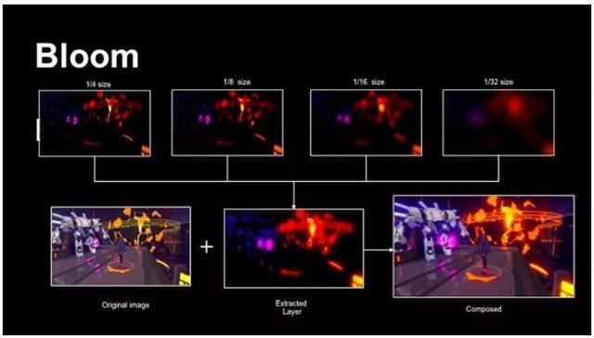
Cel shading : Additional reading
《崩坏3》中的卡通渲染 —— 如何实现bloom效果
Down sampling
Intensity threshold
4 Render target
(different size)
Gaussian Blur
Superposition
Bloom!
Source : http://baijiahao.baidu.com/s?id=1601902434507700874&wfr=spider&for=pc
Notes:
基于我们的目标，我们做了一些调查工作，去了解现在已经有哪些方法去做卡通方面的风格转换。
首先是cel-shading也就是卡通渲染。卡通渲染是NPR（非真实渲染）的一种，较早期的通过平面渲染去模仿卡通风格的方法主要有image filtering或者是其他方面优化的一些构想，比如通过最小化L0 gradient去做image smoothing.但是这类方法有一定的缺陷，就是从这些简单的数学公式上面，难以抓住众多画手各异的艺术风格。为了提升转化的质量，有了更进一步的方法——segmentation of image/video.但是同样存在问题：这些方法缺乏泛用性，对大范围、多种类的输入并不能都给出很好的结果。
关于卡通渲染，目前在产业界已经有了极大地应用。在米哈游公司的一款手游《崩坏3》中，许多场景以及特效都用到了这类技术，其中bloom效果的实现我认为对我们这次的cartoon风格转换有较大的借鉴意义。
首先是为了后续处理流程的使用，下采样到原图大小的1/4，然后是对图像中高亮区域图像的提取，这很简单，从源像素减去设定的阈值即可。接下来产生4个大小依次递半的render target并将其内容用半径逐渐增大的高斯模糊去平滑，最后将这些模糊后的效果合并起来，就得到了不错的bloom效果。
于是基于神经网络的各种风格转换算法应运而生。比如基于CNN的neural style transfer(NST)和融合了CNN特征局部匹配及马尔科夫随机场的style transfer(CNNMRF).但是这类算法也有一个问题，它们用一个单独的风格去转换一张含有内容的图片，而这个风格极大地依赖于训练数据而无视与内容的相关性，故而结果可能会有较大的内容与风格的失调。
更进一步的方法是GAN，对抗生成网络。在GAN提出以后，各种基于GAN的风格转换算法被提出，但其中大部分算法需要paired image，也就是图片与label相对应。但这样的数据着实很少，难以做出有效的训练。最近提出的CycleGAN可以用unpaired image产生较好的效果，但是它需要同时训练两个GAN models，所以训练过程十分耗时。

Slide 5
Our methods
CartoonGAN
Based on: CartoonGAN: Generative Adversarial Networks for Photo Cartoonization, Yang Chen, Yu-Kun Lai, Yong-Jin Liu, CVPR 2018

Slide 6
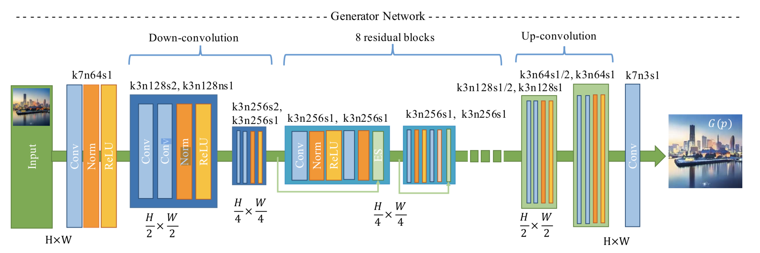
Generator Network
Notes:
G begins with a flat convolution stage followed by two down-convolution blocks to spatially compress and encode the images. Afterwards, eight residual blocks with identical layout are used to construct the content and manifold feature.

Slide 7
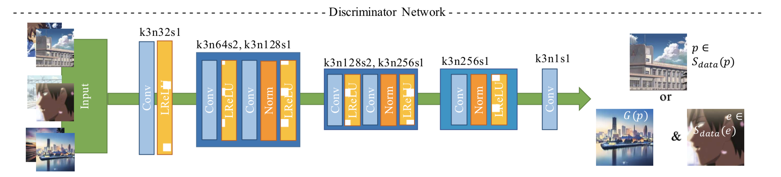
Discriminator Network
Notes:
Instead of a regular full-image discriminator, we use a simple patch-level discriminator with fewer parameters in D. Different from object classification, cartoon style discrimination relies on local features of the image. Accordingly, the network D is designed to be shallow. After the stage with flat layers, the network employs two strided convolutional blocks to reduce the resolution and encode essential local features for classification.

Slide 8
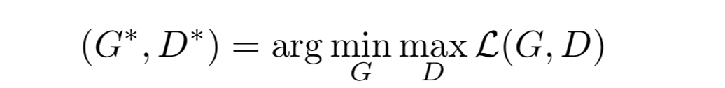
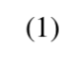
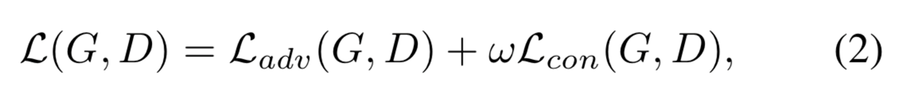
Loss Function
L(G,D) in Eq.(1) consists of two parts:
The adversarial loss L_{adv} (G, D)
which drives the generator network to achieve the de- sired manifold transformation
the content loss L_{con}(G,D)
which preserves the image content during cartoon stylization.
Notes:
Larger ω leads to more content information from the input photos to be retained, and therefore, results in stylizedimages with more detailed textures.

Slide 9
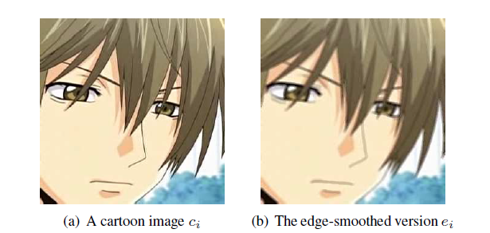
Edge Promotion
Detect edge pixels using a standard Canny edge detector
Dilate the edge regions
apply a Gaussian smoothing in the dilated edge regions
Notes:
This is because the presentation of clear edges is an important characteristic of cartoon images, but the proportion of these edges is usually very small in the whole image. Therefore, an output image without clearly reproduced edges but with correct shading is likely to confuse the discriminator trained with a standard loss.

Slide 10
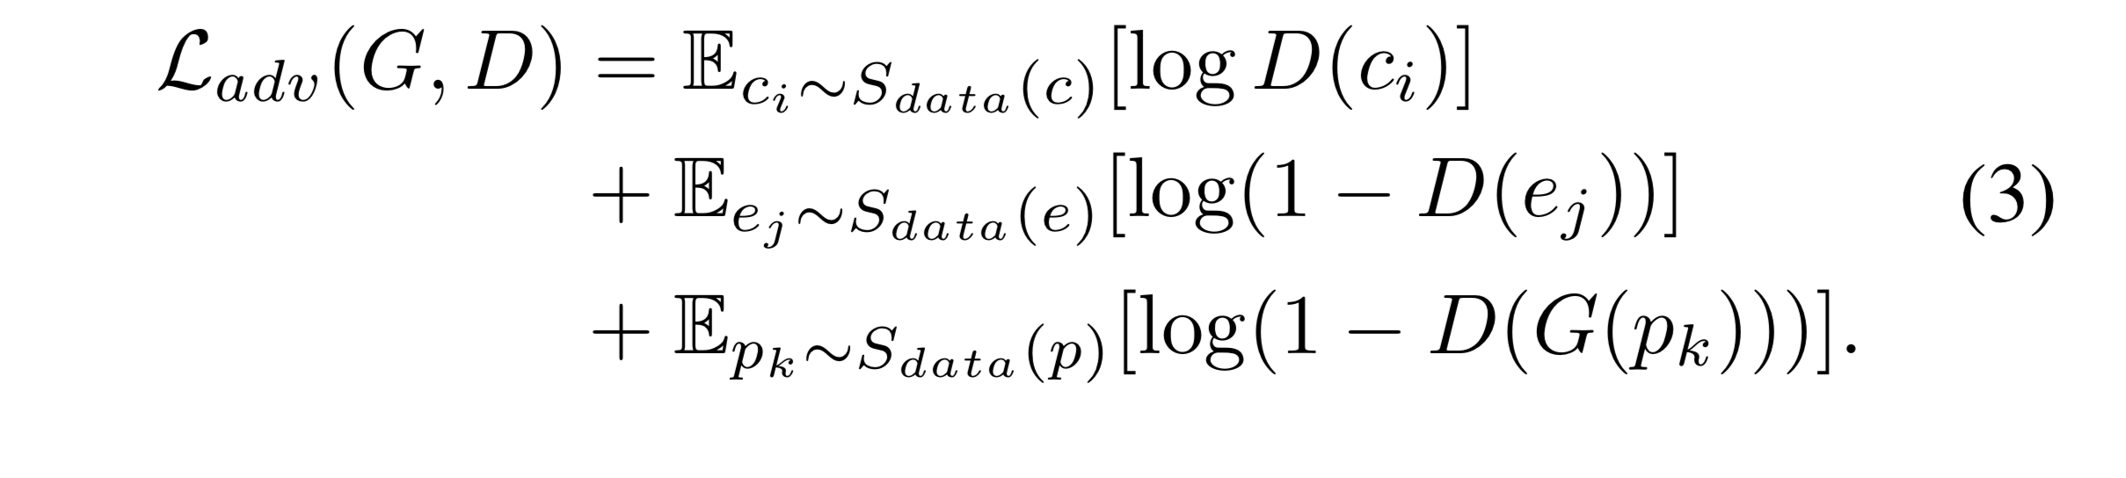
Adversarial loss L_{adv} (G, D)
In CartoonGAN, the goal of training the discriminator D is to maximize:
The probability of assigning the correct label to G(p_{k}),
the cartoon images without clear edges (i.e., e_{j}∈ S_{data}(e))
the real cartoon images (i.e., c_{i}∈ S_{data}(c))
The second item is added to L_{adv} (G, D) of usuall GANs.

Slide 11
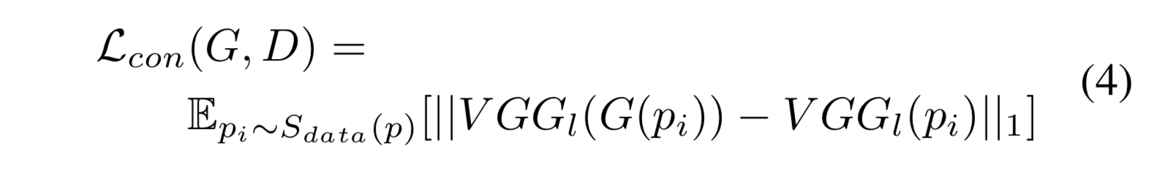
Content loss L_{con}(G, D)
In addition to transformation between correct manifolds, one more important goal in cartoon stylization is to ensure the resulting cartoon images retain semantic content of the input photos.
In CartoonGAN, we adopt the high-level feature maps in the VGG network, which has been demonstrated to have good object preservation ability.
Notes:
We observe that even with a suitable VGG layer that intends to capture the image content, the feature maps may still be affected by the massive style difference. Such differences often concentrate on local regions where the representation and regional characteristics change dramatically. ℓ1 sparse regularization is able to cope with such changes much better than the standard ℓ2 norm.

Slide 12
Initialization phase
Since the GAN model is highly nonlinear, with random initialization, the optimization can be easily trapped at suboptimal local minimum.
To help improve its convergence, we propose a new initialization phase.
We start the adversarial learning framework with a generator which only reconstructs the content of input images. For this purpose, in the initialization phase, we pre-train the generator network G with only the semantic content loss L_{con}(G, D).

Slide 13
Data
Real-world photos (7000+ images)
Cartoon images (900+ images)
All the training images are resized and cropped to 256×256.

Slide 14
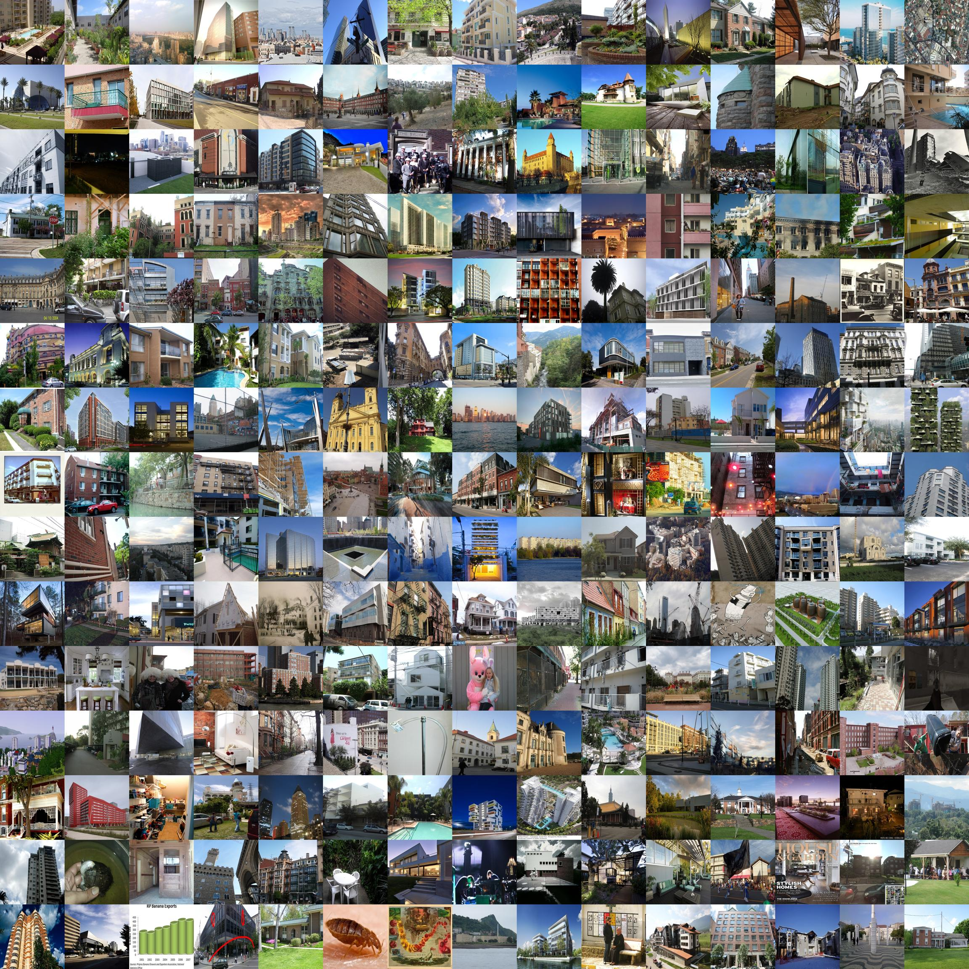
Real-world dataset
From search engines
From other datasets

Slide 15
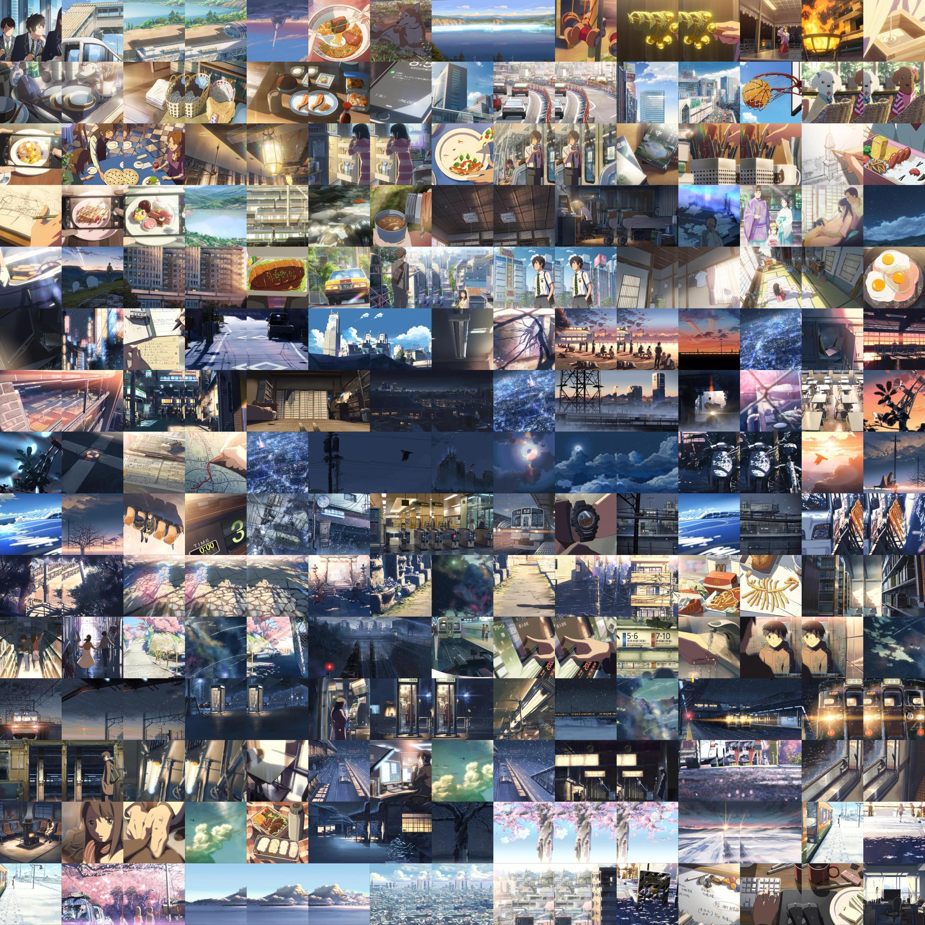
Cartoon images
Manually captured in cartoons

Slide 16
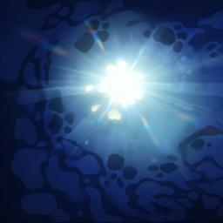
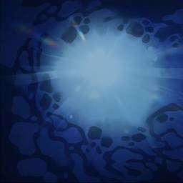
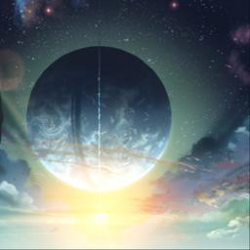
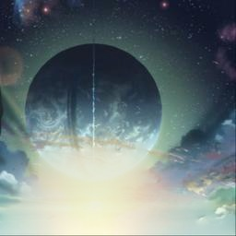
Illumination Change
Original
Illuminated
Original
Illuminated

Slide 17
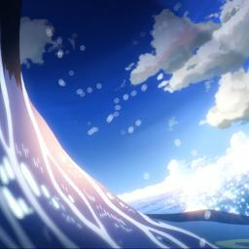
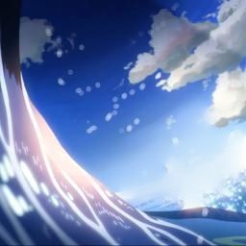
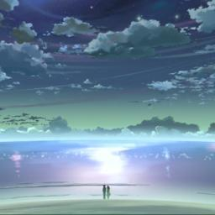
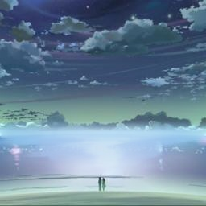
Illumination Change
Original
Illuminated
Original
Illuminated

Slide 18
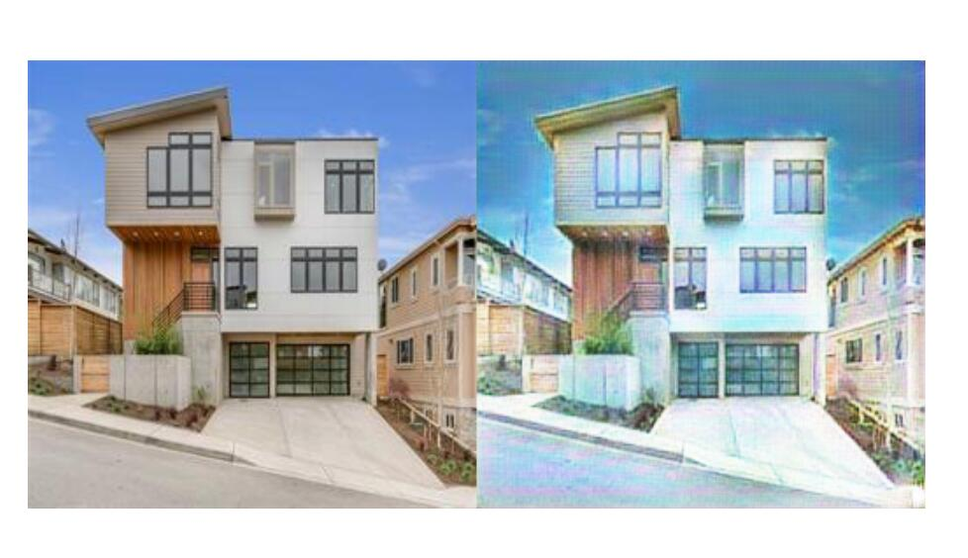
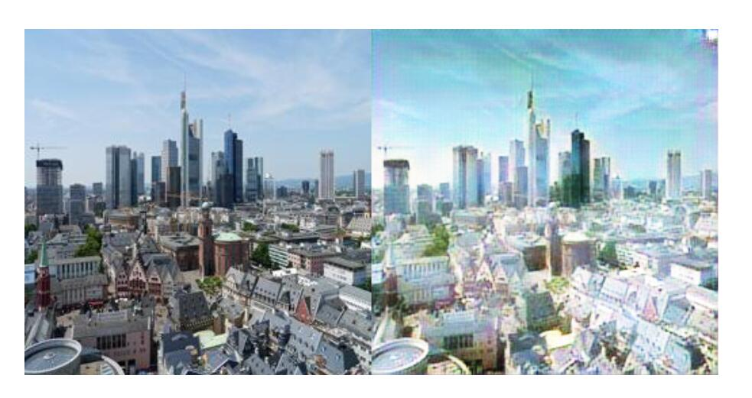
Result & Discussion
Original
Cartoonized
Original
Cartoonized

Slide 19
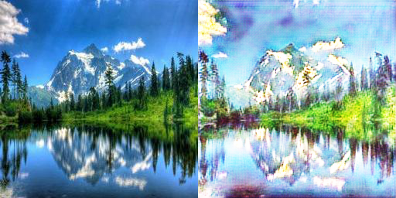
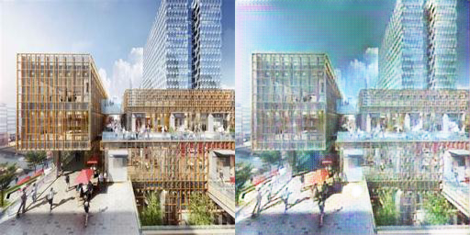
Result & Discussion
Original
Cartoonized
Original
Cartoonized

Slide 20
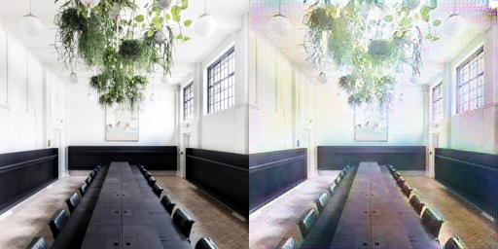
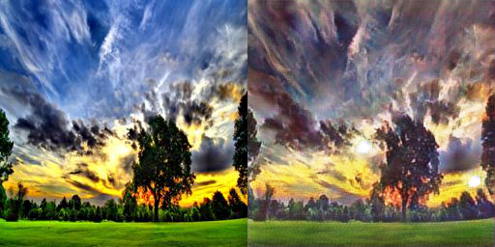
Result & Discussion
Original
Cartoonized
Original
Cartoonized

Slide 21
Reference
Image filtering
[H. Winnem oller, S. C. Olsen, and B. Gooch. Real-time video abstraction. ACM Transactions on Graphics, 25(3):12211226, 2006.]
Formulations in optimization problems
[L. Xu, C. Lu, Y. Xu, and J. Jia. Image smoothing via L0 gradient minimization. ACM Transactions on Graphics, 30(6):174, 2011.]
Alternative methods rely on segmentation of images/videos
[J. Wang, Y. Xu, H.-Y. Shum, and M. F. Cohen. Video toon-ing. ACM Transactions on Graphics, 23(3):574–583, 2004]
Dedicated methods have also been developed for portraits
[M. Yang, S. Lin, P. Luo, L. Lin, and H. Chao. Semantics-driven portrait cartoon stylization. In International Conference on Image Processing, 2010.] [P. L. Rosin and Y.-K. Lai. Non-photorealistic rendering of portraits. In Workshop on Computational Aesthetics, pages 159–170, 2015.]
A neural style transfer (NST) method based on CNNs that transfers the style from the style image to the content image
[L. Gatys, A. Ecker, and M. Bethge. Image style transfer using convolutional neural networks. In IEEE Conference on Computer Vision and Pattern Recognition (CVPR), pages 2414–2423, 2016.]
Style transfer by local matching of CNN feature maps and using a Markov Random Field for fusion (CNNMRF)
[C. Li and M. Wand. Combining Markov random fields and convolutional neural networks for image synthesis. In IEEE Conference on Computer Vision and Pattern Recognition (CVPR), pages 2479–2486, 2016.]
A Deep Analogy method which keeps semantically meaningful dense correspondences between the content and style images while transferring the style
[J. Liao, Y. Yao, L. Yuan, G. Hua, and S. B. Kang. Visual attribute transfer through deep image analogy. ACM Transactions on Graphics, 36(4):120, 2017.]
A method to improve comic style transfer by training a dedicated CNN to classify comic/non-comic images
[Y. Chen, Y.-K. Lai, and Y.-J. Liu. Transforming photos to comics using convolutional neural networks. In International Conference on Image Processing, 2017.]
pixel-to-pixel image synthesis problems.
[V. Dumoulin, I. Belghazi, B. Poole, A. Lamb, M. Arjovsky,O. Mastropietro, and A. Courville. Adversarially learned inference. In International Conference on Learning Representations (ICLR), 2017.]
[P. Isola, J.-Y. Zhu, T. Zhou, and A. A. Efros. Image-to-image translation with conditional adversarial networks. In IEEE Conference on Computer Vision and Pattern Recognition (CVPR), 2017.]
[L. Karacan, Z. Akata, A. Erdem, and E. Erdem. Learning to generate images of outdoor scenes from attributes and semantic layouts. arXiv preprint arXiv:1612.00215, 2016.]
CycleGAN
[J.-Y. Zhu, T. Park, P. Isola, and A. A. Efros. Unpaired image-to-image translation using cycle-consistent adversarial networks. In International Conference on Computer Vision, 2017.]
Residual blocks
[K. He, X. Zhang, S. Ren, and J. Sun. Deep residual learning for image recognition. In IEEE Conference on Computer Vision and Pattern Recognition (CVPR), pages 770778, 2016.]
Batch normalization
[S. Ioffe and C. Szegedy. Batch normalization: Accelerating deep network training by reducing internal covariate shift. In International Conference on Machine Learning, pages 448456, 2015.]

Slide 22
THANKS

